Slide 1

CORONA VIRUS ANALYSIS
SQL AND DATA ANALYSIS SKILLS REAL-WORLD PROJECT
BY: HARSH SAHU

Slide 2
TABLE OF CONTENTS
Project Overview
Dataset Description
Data Exploration and Analysis

Slide 3
Project Overview
The CORONA VIRUS pandemic has had a significant impact on public health and has created an urgent need for data-driven insights to understand the spread of the virus. As a data analyst, you have been tasked with analyzing a CORONA VIRUS dataset to derive meaningful insights and present your findings.

Slide 4
Dataset Description
Description of each column in dataset:
1) Province: Geographic subdivision within a country/region.
2) Country/Region: Geographic entity where data is recorded.
3) Latitude: North-south position on Earth's surface.
4) Longitude: East-west position on Earth's surface.
5) Date: Recorded date of CORONA VIRUS data.
6) Confirmed: Number of diagnosed CORONA VIRUS cases.
7) Deaths: Number of CORONA VIRUS related deaths.
8) Recovered: Number of recovered CORONA VIRUS cases.

Slide 5
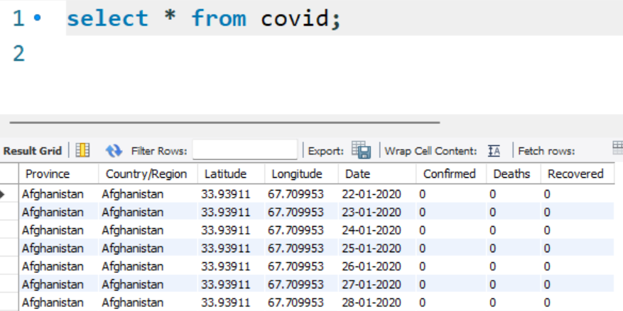
Data Set Description:

Slide 6
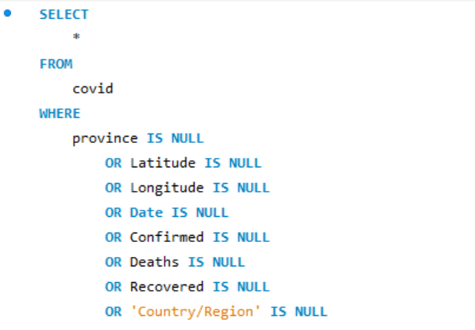
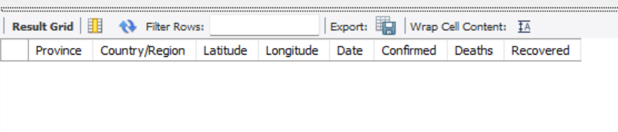
Q1. Write a code to check NULL values
No Null values found in the data set

Slide 7
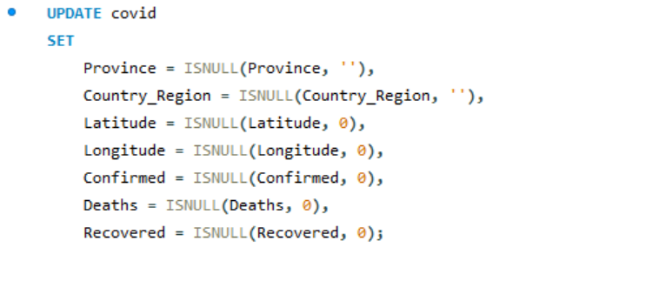
Q2. If NULL values are present, update them with zeros for all columns.

Slide 8

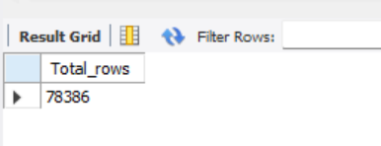
Q3. check total number of rows

Slide 9
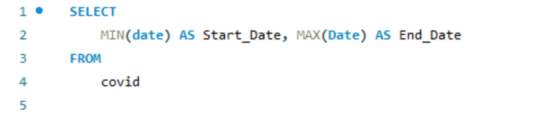
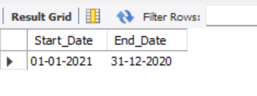
Q4. Check what is start_date and end_date

Slide 10
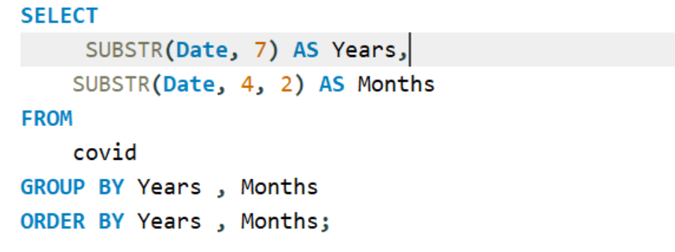
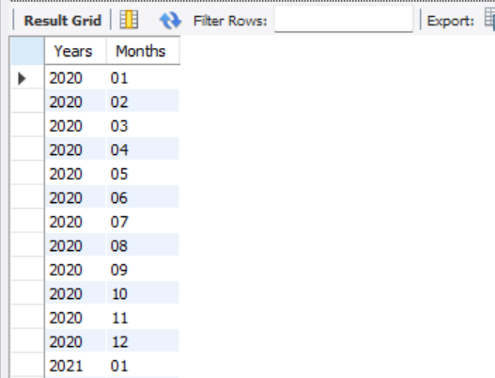
Q5. Number of month present in dataset

Slide 11
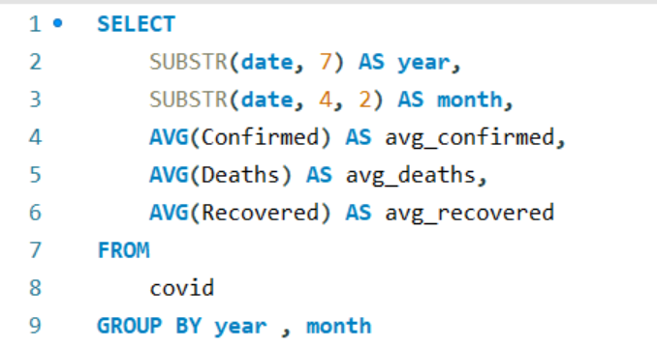
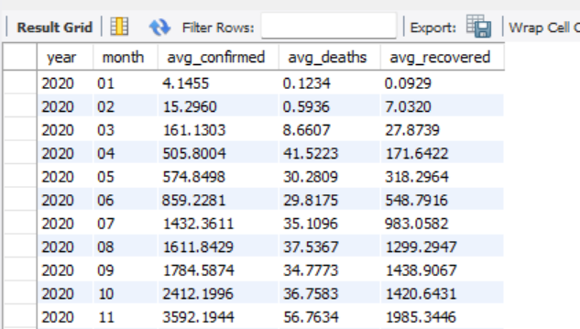
Q6. Find monthly average for confirmed, deaths, recovered

Slide 12
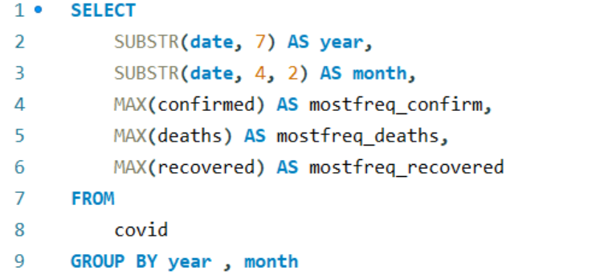
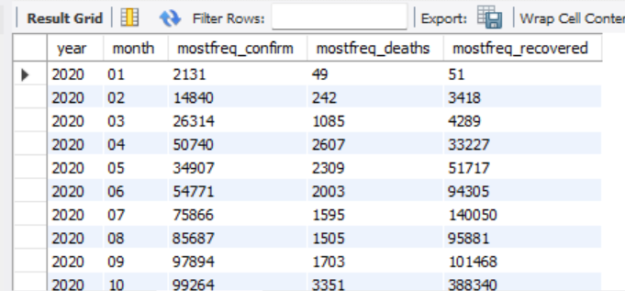
Q7. Find most frequent value for confirmed, deaths, recovered each month

Slide 13
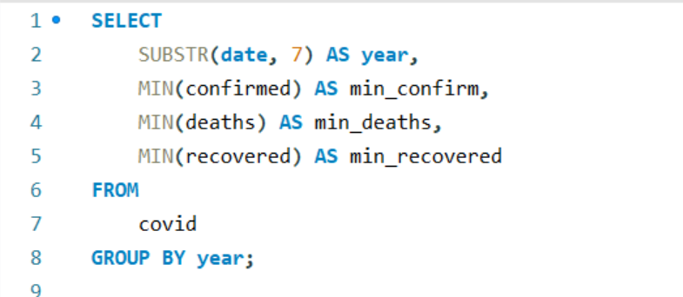
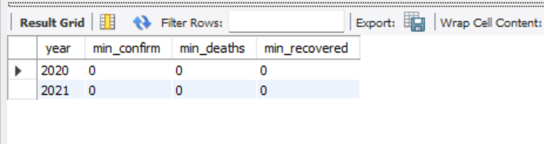
Q8. Find minimum values for confirmed, deaths, recovered per year

Slide 14
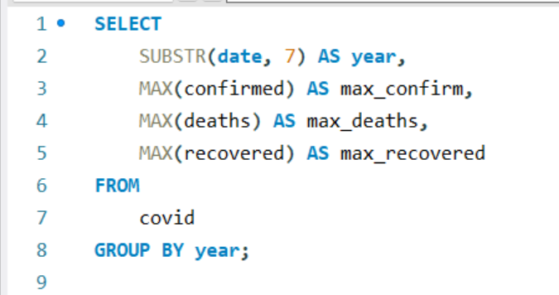
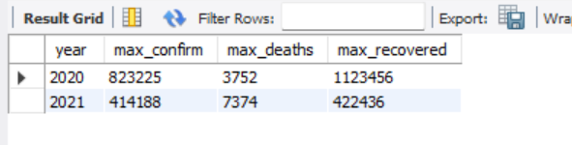
Q9. Find maximum values of confirmed, deaths, recovered per year

Slide 15
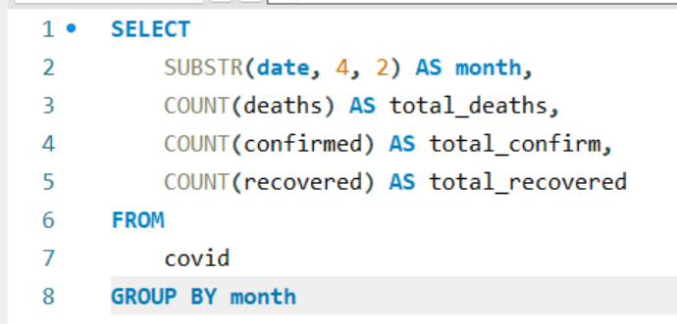
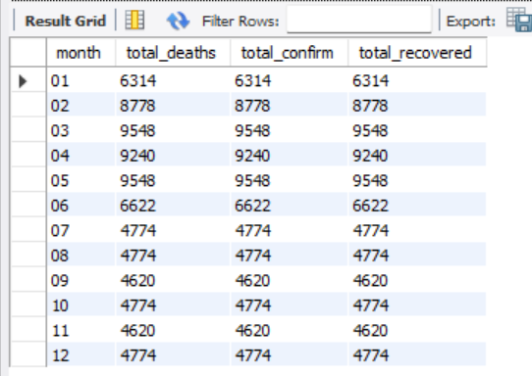
Q10. The total number of case of confirmed, deaths, recovered each month

Slide 16
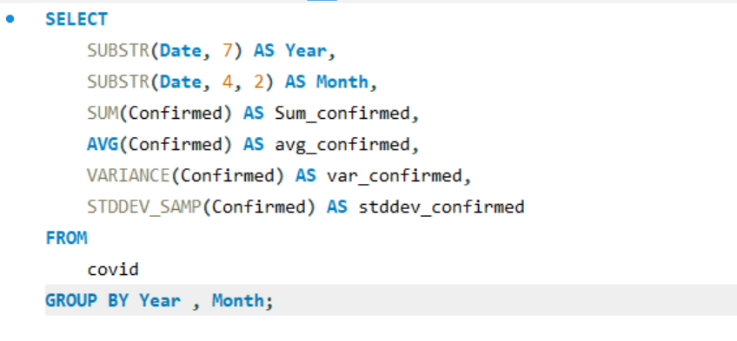
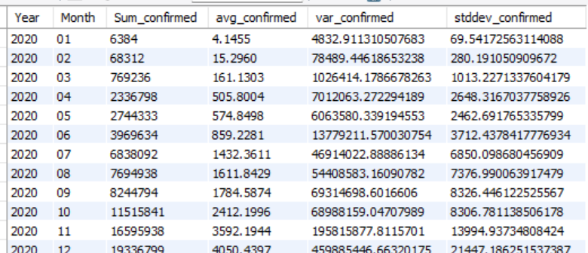
Q11. Check how corona virus spread out with respect to confirmed case (Eg.: total confirmed cases, their average, variance & STDEV )

Slide 17
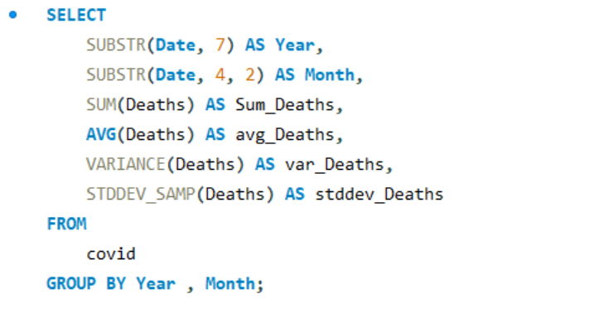
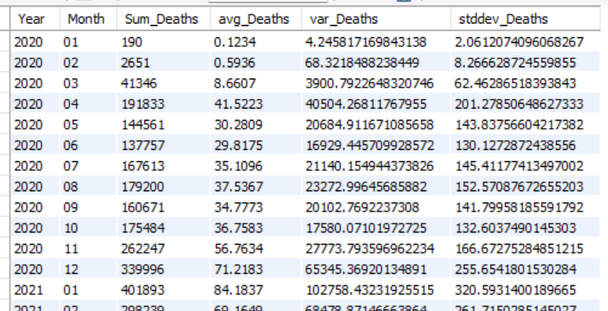
Q12. Check how corona virus spread out with respect to death case per month (Eg.: total confirmed cases, their average, variance & STDEV )

Slide 18
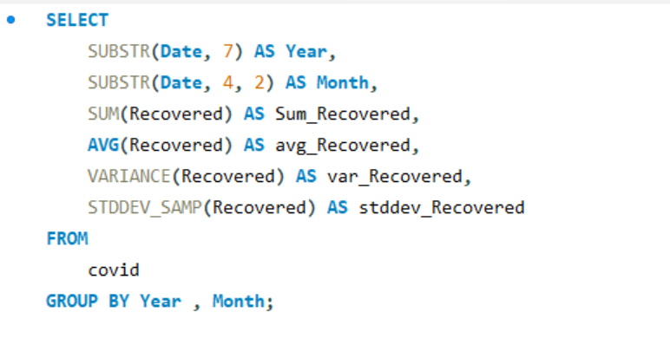
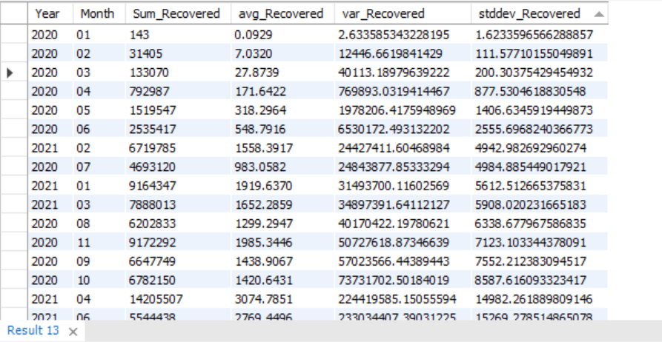
Q13. Check how corona virus spread out with respect to recovered case (Eg.: total confirmed cases, their average, variance & STDEV )

Slide 19
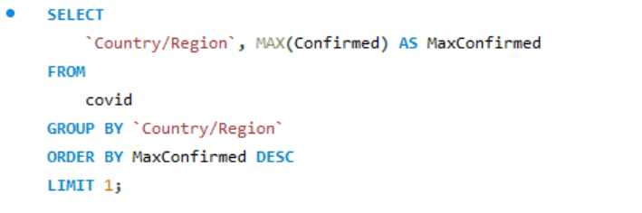
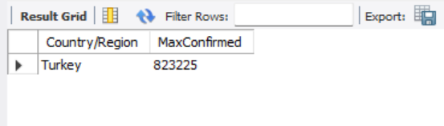
Q14. Find Country having highest number of the Confirmed case

Slide 20
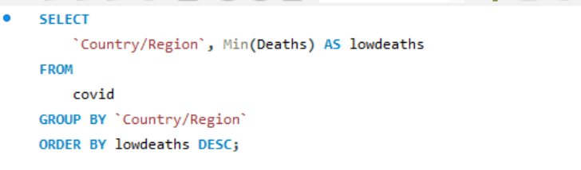
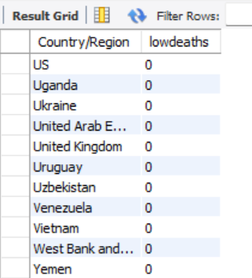
Q15. Find Country having lowest number of the death case

Slide 21
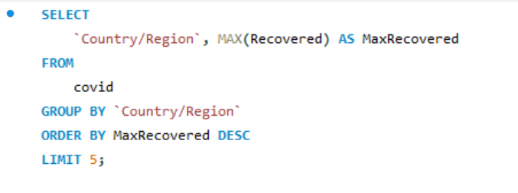
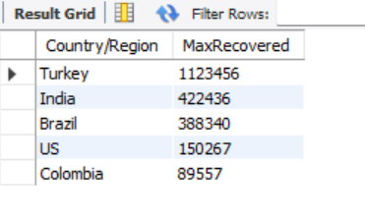
Q16. Find top 5 countries having highest recovered case

Slide 22
THANK YOU

